Slide 1

COVID-19 in New York City

Slide 2
Introduction
Background :
As the coronavirus spreads across the globe, it appears that :
each country, each state, each city, is not affected in the same way.
even within the same city, inequalities are huge.
Objective :
Study the way coronavirus is affecting the different neighborhoods of New York City, related to some demographic statistics and to the disparity of services provided in these neighborhoods.

Slide 3
Data sources (1/2)
Geographic data
Zip Codes, latitudes and longitudes and square miles of each neighbourhood
A Github project was used to collect a CSV file which includes USA zipcode programmable database and geometry information. Link : https://github.com/MacHu-GWU/uszipcode-project
Neighbourhood and boroughs names
A table published by the Department of Health of New York State was used in order to define the name of boroughs and neighborhoods. It was converted in an Excel file. Link: https://www.health.ny.gov/statistics/cancer/registry/appendix/neighborhoods.htm
New-York City Demographic statistics
The website provides detailed, informative profiles for every city in the United States by zip code. It allowed us to collect information as the density, the median house value, the median age, the average household size, the average Adjusted Gross Income (AGI) or the average wage, for each neighborhood. Link: http://www.city-data.com/
Map of the neighbourhoods
A GeoJSON file - website of the New York University Link: https://geo.nyu.edu/catalog/harvard-tg00nyzcta

Slide 4
Data sources (2/2)
COVID-19 data
A Github project was used to collect a CSV file which counts the number of New York City residents by ZIP code of residence who were tested positive for COVID-19 (SARS-CoV-2). Link: https://github.com/nychealth/coronavirus-data
Provided services in the neighborhoods
The Foursquare API was used in order to find the number of provided services in each neighbourhood. We gathered the number of venues of different categories within a distance of 500 meters of the center of the neighborhood. Link: https://developer.foursquare.com/docs/

Slide 5
Methodology (1/3)
Feature selection
10 features for each ZIP code:
Percentage of population tested positive for COVID-19 [%]
Density [per square mile]
Median house value [$]
Median age [years]
Average household size [people]
Average annual Wage [$]
Number of medical center venues [-]
Number of art and entertainment venues [-]
Number of outdoor and recreation venues [-]
Number of shop and service venues [-]

Slide 6
Methodology (2/3)
Unsupervised learning: Clustering
The first model we will deploy is an unsupervised learning algorithm. We will use the k-means clustering algorithm in order to group the neighborhoods into clusters using the selected features.
Create the model using KMeans() function from the sklearn.cluster Python library
Iterate the model for different numbers of clusters (from 1 to 10)
Chose the right number of clusters looking at the Elbow method (using the inertia_ method) and Silhouette score (using the silhouette_score function from sklearn.metrics Python library)
Run the model with the selected number of clusters
Visualize the neighbourhoods in New York City and their emerging clusters using the Folium library.

Slide 7
Methodology (3/3)
Supervised learning: Regression models
The second model we will deploy is a supervised learning algorithm. We will use the multi-linear regression algorithm in order to try to find a correlation between the percentages of population tested positive for COVID-19 (dependent feature) versus the selected independent features.
Split the dataset into training and testing sets
Create the model using LinearRegression() function from the sklearn.linear_model Python library
Fit the model with the training dataset
Predict the test values
Calculate the Variance score and the R2-score using sklearn.metrics Python library

Slide 8
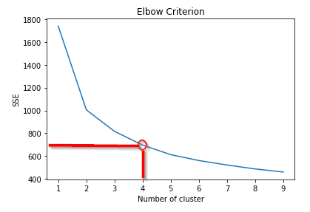
Results & Discussion (1/5)
Unsupervised learning: Clustering
Choose K=4

Slide 9
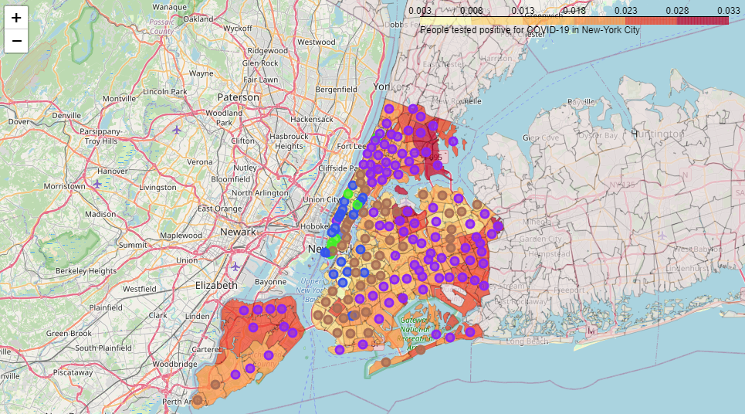
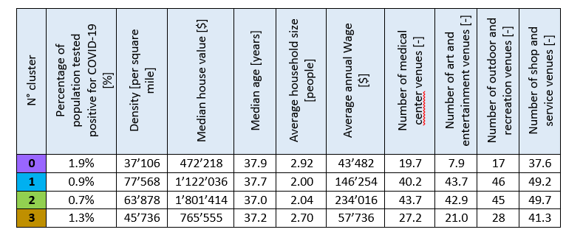
Results & Discussion (2/5)
Unsupervised learning: Clustering
Vizualize Centroids

Slide 10
Results & Discussion (3/5)
Unsupervised learning: Clustering
Clusters 0 and 3, which are the most affected by COVID-19, appears to be linked to the poorest neighborhoods, with the lowest access to medical facilities.
On the contrary, clusters 1 and 2, which are the most affected by COVID-19, appears to be linked to the wealthiest neighborhoods, with the highest access to medical facilities.

Slide 11
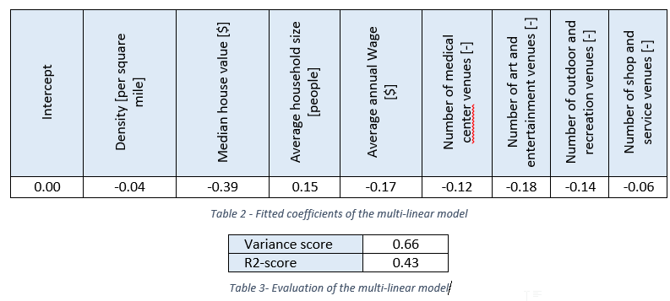
Results & Discussion (4/5)
Supervised learning: Regression models

Slide 12
Results & Discussion (5/5)
Supervised learning: Regression models
The variance and R2-score are not really good. Indeed, it means that we need other features in order to perfectly predict the percentages of population tested positive for COVID-19 in each neighborhood. The COVID-19 rate is not only linked to demographic features but also to medical features like the rate of comorbid medical conditions in the population, features related to jobs, etc.
However, we find the same trends in the correlation between the rates of infected population, against the poverty and the access to medical facilities

Slide 13
Conclusion
Why COVID-19 is not equally affecting the different neighborhoods of New York City ?
Some of the features which are playing an important role are the poverty and the access to medical facilities.
Indeed, people with low income are living in less favorable conditions (more people in each home) and have higher rates of chronic health conditions such as diabetes or heart disease which are considered as comorbid medical conditions. Moreover, in general, they held less-skilled jobs which are more exposed to the virus (cashier, cleaning person, caregiver, delivery man, etc.).
Then, this study could be developed by exploring further features linked to the health condition and the jobs occupied by these populations.

